Slide 1
Volkswagen used car market insights and predictions
HANDE TOKGOZ UTKU
Date:

Slide 2
What are the top 3 data points that impact the used Volkswagen car prices in the market?
1
Being able to predict car prices will be very helpful to car buyers, sellers and used car galleries.
Efficient pricing would bring a more efficient and fair market.
Problem 1
There is no reliable prediction model to come up with the right price of a car
2
Even though we come up with an equation, categorical variables would still impact car prices a lot, so a second iteration of modelling is always possible.
Problem 2
There are many categorical and continuous variables that impact car prices

Slide 3
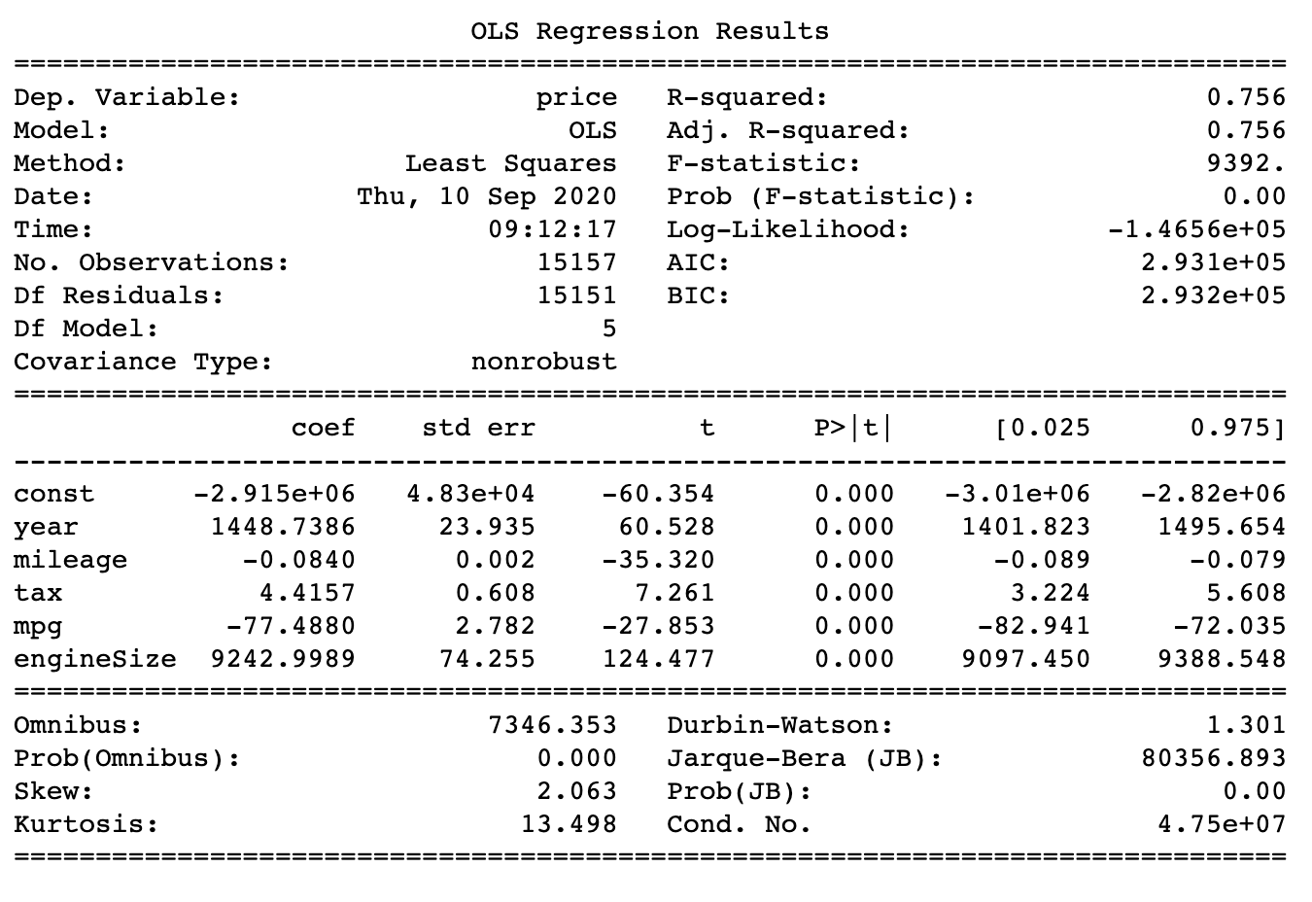
Regression – Key Insights
The model we built predicts price as an equation of independent variables year, tax, mileage, MPG and engine size.
With a R-squared value of .756, the model is reliable for most cases and predicts prices accurately.
The model performs better for prices under 25,000 and skews more when price is higher.
80% of all prices are below 25,000.
Categorical factors such as transmission, model and fuel type should also be taken into consideration since these also have considerable impact on prices.

Slide 4
We applied Descriptive and Inferential statistics to uncover which metrics could be impacting the used car prices
What are the top 3 data points that impact the used Volkswagen car prices in the market?
Descriptive Statistics
Box Plots
Scatter Plots
Line Plots
Inferential Statistics
Regression
Correlation

Slide 5
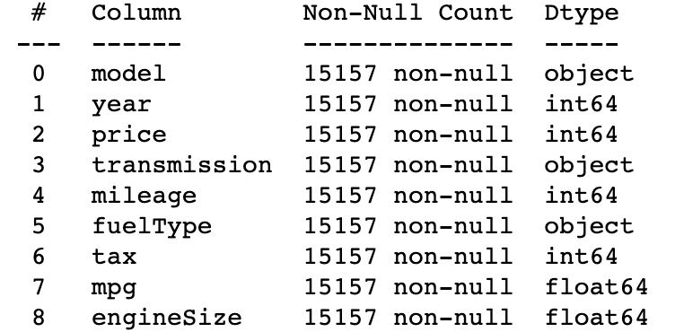
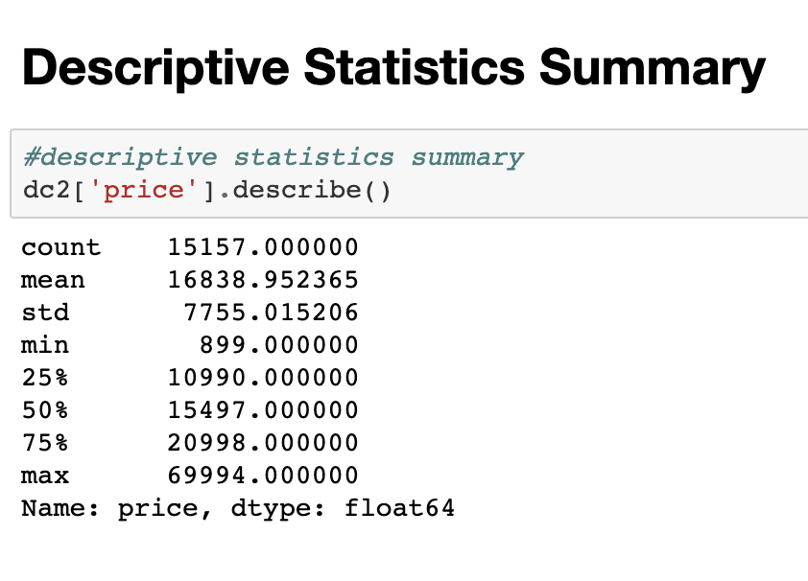
Summary of Dataset Used Columns & Descriptive Statistics Summary
The analysis is based on 15.157 Volkswagen used car sales between the years of 2000 and 2020. The dataset has the below variables:
Price (continuous): Sale price of car
Model (categorical): Model of car
Year (continuous): Model year of car
Transmission Type (categorical): Transmission system of car
Mileage (continuous): Miles on car odometer when sold
Fuel Type (categorical): Fuel system of car
Tax (continuous): Sales tax of car
MPG (continuous): Miles the car can be driven with a gallon of fuel
Engine Size (continuous): Size of car engine in liters
There were no null values in any of the fields so we did not do any cleansing to start with.

Slide 6
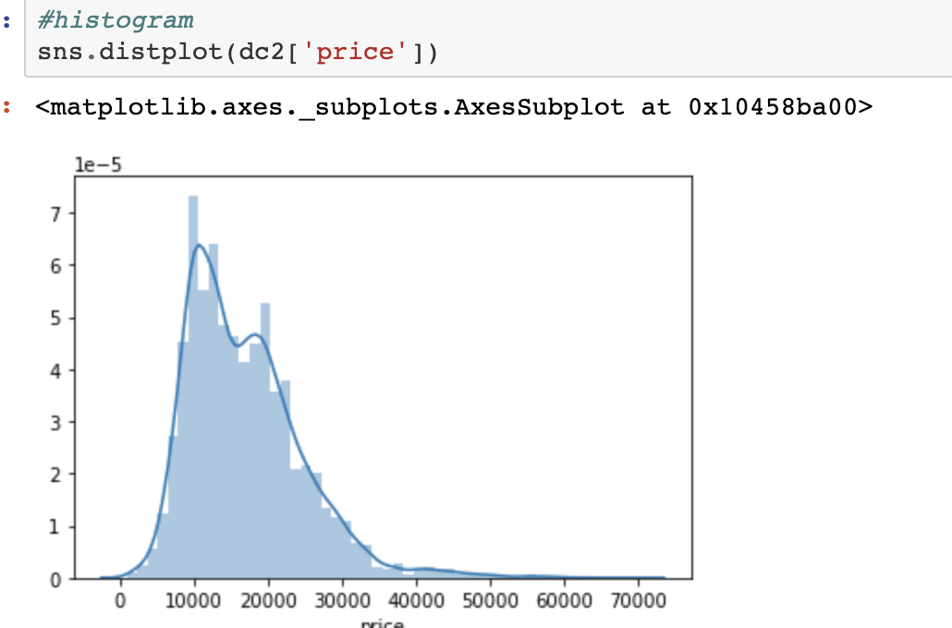
Histogram of Car Prices
The histogram shows an asymmetric distribution of car prices.
Car prices are mostly between 10.000 and 20.000.
The car price histogram is significantly left skewed.

Slide 7
Correlation Matrix of Variables
Model year is the top factor determining the prices.
Year and engine size are the top positively correlated data points when determining the prices.
Mileage and MPG are the top negatively correlated data points when determining the prices.
Looking at the whole dataset we can see the highest correlation is between mileage and year and the correlation is negative.

Slide 8
We were able to see that automatic cars, cars with larger engines, hybrid cars, and California, Caravelle, Touareg models have higher prices.
Amarok, Arteon and Tiguan Allspace are other highly priced models.
Average prices of most popular models | Golf: $16.7k, Polo: $11.3k, Tiguan: $21.6k
3.0 engine and Touareg car model had high price variety.

Slide 9
Mileage and MPG are negatively correlated with price as we can also confirm on these scatterplots.
MPG is negatively correlated with price.
Highly priced luxury cars such as SUVs are known to have lower MPG
A closer look to the scatter plot supports the strong negative correlation.
Mileage is negatively correlated with price
Higher mileage means that the car would have more wear and tear over the years.
A closer look to the scatter plot supports the negative correlation.

Slide 10
APPENDIX: SCATTERPLOT OF ALL CONTINUOUS VARIABLES

